Slide 1
Impact of Inflation and Unemployment on Economic Growth
Thesis Presentation
Presented by: Muhammad Usman (19U00282)

Slide 2
Introduction
The purpose of this research is to assess the influence that inflation and unemployment would have on Economic Growth.
The growth rate serves as the dependent variable in the economic model, while inflation, unemployment, the exchange rate, the money supply, investment, interest rate and the savings rate served as independent variables.
Unemployment and Inflation are problems at the heart of every country's social and economic life. Existing literature points to inflation and unemployment as twin problems explaining the nature of poverty in developing countries.
Inflation increases the cost of the country and creates more financial problems by increasing the cost of goods and services and other factors (Rasheed et al., 1997).
All economies intend to keep both in the lowest single digits as this creates stability in the country's macroeconomic policies.
This stability is very important for the effective growth and development of the economy and for the achievement of economic policy goals and objectives (Orji et al., 2015).

Slide 3
Literature Review (Theoretical Literature)
Phillip’s Curve (1958)
Phillips created the piece of work that is often referred to as "the Phillips curve" in 1958.
The Phillips curve depicts the typical link between pay behavior and unemployment rates over the economic cycle.
He found a short-term trade-off among inflation and unemployment. Therefore, he proposed the hypothesis that increasing inflation might be caused by dropping unemployment and that decreasing inflation could be achieved by enabling unemployment to grow.
Okun’s Law (1962)
States that a 1% drop in the rate of employment would lead to a loss of roughly 3% GDP.
If the causation were reversed, a 1% rise in unemployment would result in a loss of GDP growth of around 3%.

Slide 4
Literature Review (Theoretical Literature)
The General Theory of Employment, Interest, and Money, written by John Maynard Keynes (1936)
This theory laid the groundwork for Keynesian economics.
Keynesians believe that for efficiency to be at its highest, government intervention is required.
They believe that governmental intervention in the market via expansionary economic policies will spur demand and boost investment, enabling full production.
Quantity theory of Money (1956)
Milton Friedman
Quantity Theory of Money linked inflation and economic growth by simply matching the entire amount of economic spending to the total amount of money in circulation.
Monetary theory argues that money expansion has a longer-term, more significant effect on pricing than it does on growth. If the money supply is growing more quickly than the economy, inflation will happen.

Slide 5
Literature Review (Theoretical Literature)
Neo-Classical Growth Model (2002)
Solow and Swan
The neoclassical economics theory of growth is based on the idea that labor and capital have declining returns when used individually, but constant returns when used together.
Relates Labor, Capital to Economic Growth.

Slide 6
Model-Equation-Hypothesis
Y_{it} = β₀ + β₁ Infl_{it} + β₂ Unemp_{it} + β₃ ER_{it} + β₄ MS_{it} + β₅ Inv_{it} + β₆ Sav_{it}+ β₇ IR_{it} + µ_{it}
Null Hypothesis
H₀ : β₁ = 0 H₀ : β₂ = 0
Impact of Inflation on Economic Growth is insignificant, β₁ equal to 0.
Impact of Unemployment on Economic Growth is insignificant, β₂ equal to 0.
Alternate Hypothesis
H₁ : β₁ ≠ 0 H₁ : β₂ ≠ 0
Impact of Inflation on Economic Growth is significant, β₁ is not equal to 0.
Impact of Unemployment on Economic Growth is significant, β₂ is not equal to 0.

Slide 7
Summary Statistics

Slide 8
Summary Statistics

Slide 9
Summary Statistics: Developed Countries Data

Slide 10
Summary Statistics: Developed Countries Data

Slide 11
Summary Statistics: Developing Countries Data

Slide 12
Summary Statistics: Developing Countries Data

Slide 13
Correlation Matrix

Slide 14
Correlation Matrix: Developed Countries

Slide 15
Correlation Matrix: Developing Countries

Slide 16
T-test of Mean Comparison
H₀: no significant difference between means of the variables in developed countries and developing countries.
H₁: significant difference between means of the variables in developed countries and developing countries

Slide 17


Descriptive (Average 2021)

Slide 18
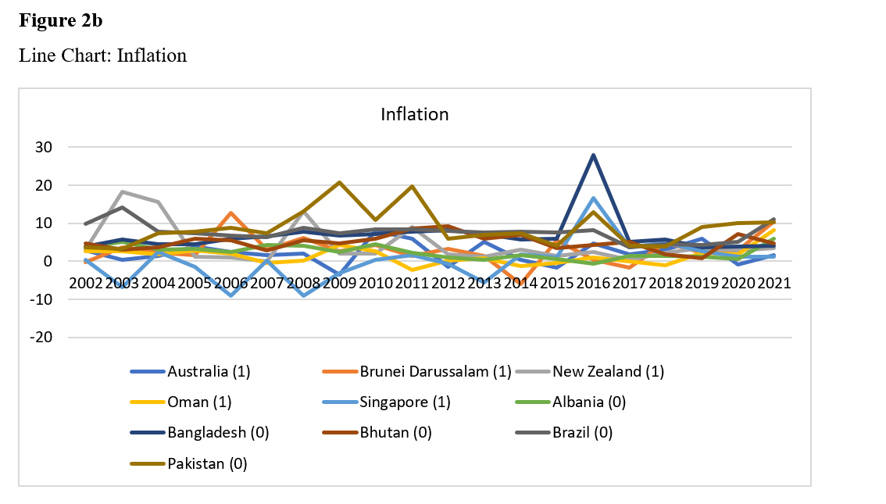
Descriptive : Inflation (2002-2021)

Slide 19
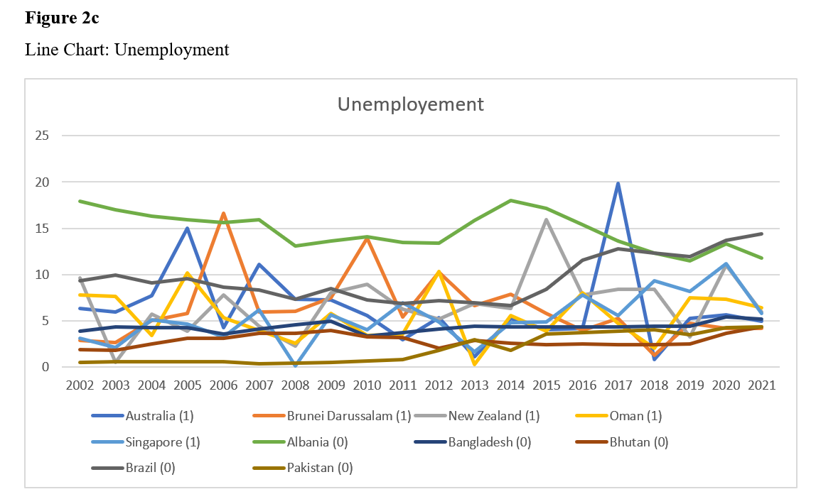
Descriptive : Unemployment (2002-2021)

Slide 20
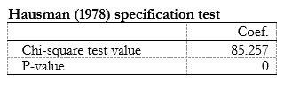
Hausman (Overall)
Hausman Hypothesis:
H_{o}: No Differences in coefficients
H₁: Significant Differences in coefficients
Notes:
It basically tests whether the unique errors (ui) are correlated with the regressors; the null hypothesis is they are not.

Slide 21
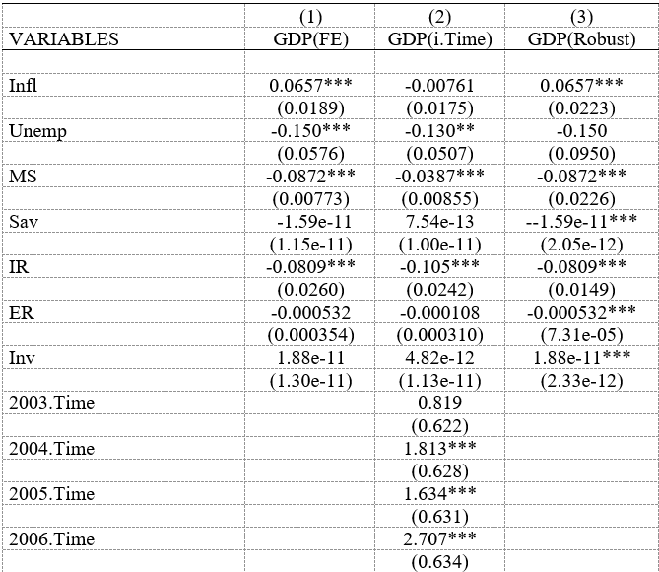
Regression (Overall)

Slide 22
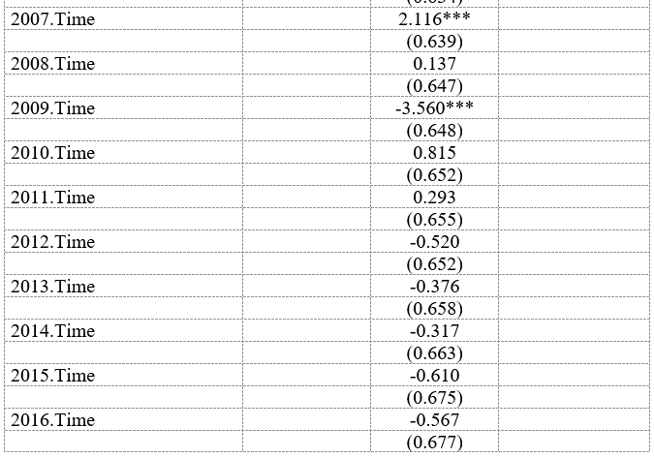
Regression (Overall)

Slide 23
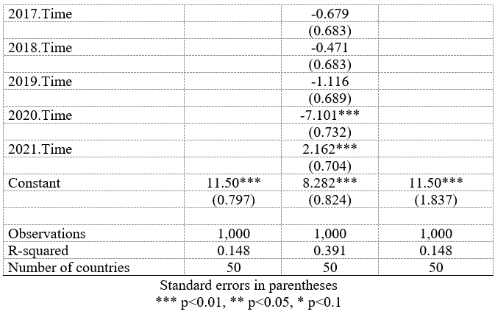
Regression (Overall)

Slide 24
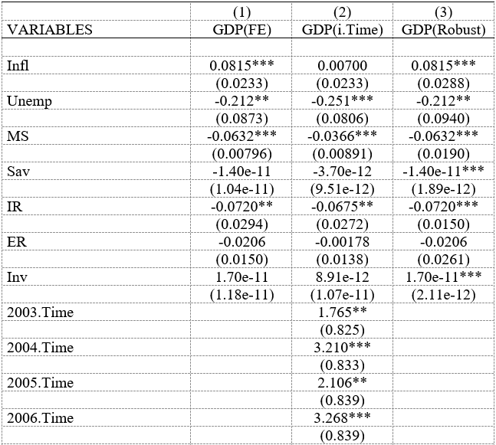
Regression (Developed)

Slide 25
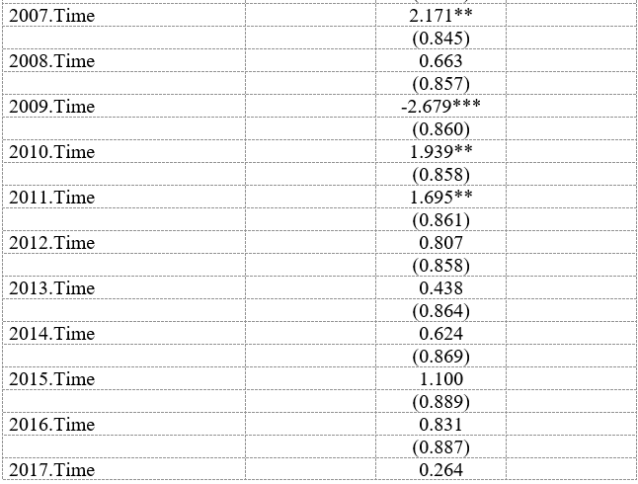
Regression (Developed)

Slide 26
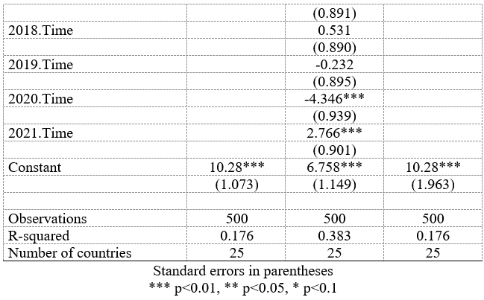
Regression (Developed)

Slide 27
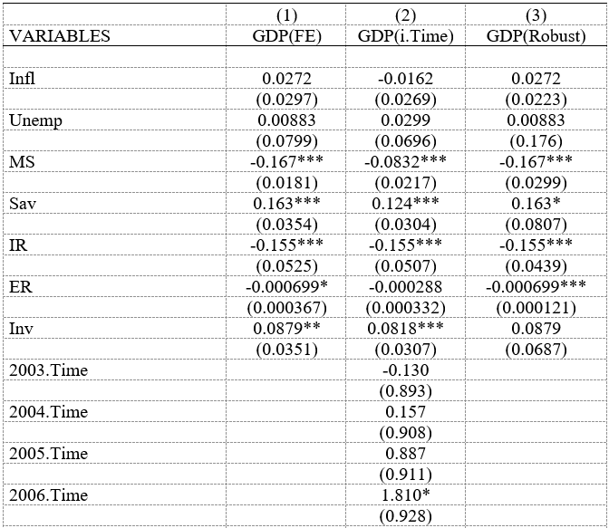
Regression (Developing)

Slide 28
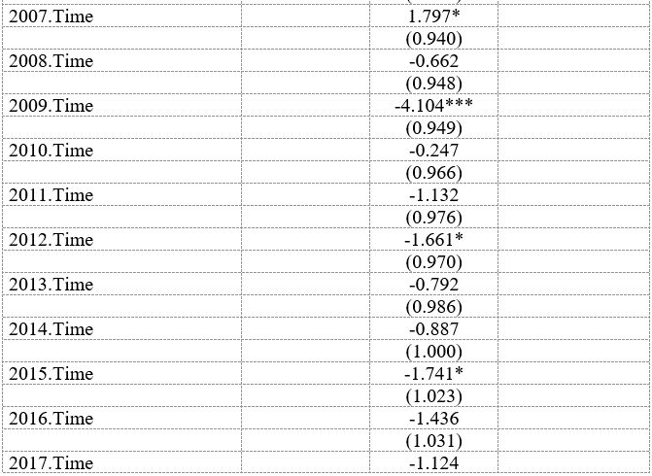
Regression (Developing)

Slide 29
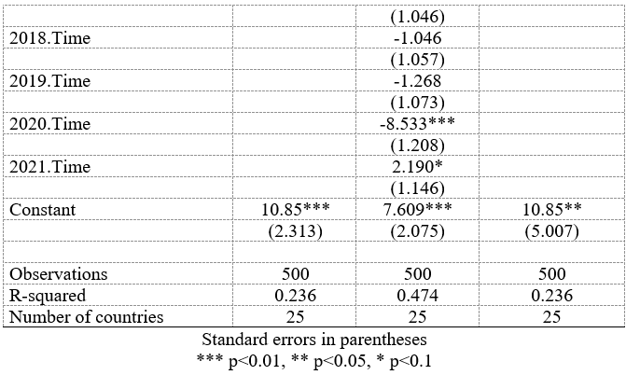
Regression (Developing)

Slide 30
Policy Recommendations
Create more job opportunities and stimulate economic activity. These efforts will lead to a reduction in unemployment and prices of commodities, ultimately improving the overall economy.
Inflation needs to be tackled differently for developed and developing countries according to the results in this research.
For developed countries a combination of monetary and fiscal policies can be used to induce economic growth .
For developing countries need to focus on development and factors such as Savings Rate, Interest Rate and Exchange Rate management.

Slide 31
Policy Recommendations
For Developing countries, policy makes should find a golden balance between inflation and economic growth as poverty levels may increase sharply if higher inflation is set as a target.
The policies and level of intervention would differ from country to country, therefore tailoring and structural reforms are needed that suits a particular economy.
Developing countries, they should diversify their dependance on many sectors rather than focusing on just one or two. This would also allow them some cushion from external shocks.

Slide 32
Implications
It would have been better to include more countries over a more extended period of time and with a larger number of observations to provide better results.
Although including more years would increase the number of observations and make the results more accurate but there may be presence of short-term relations, therefore shorter time period regressions may also yield better results.
More variable could be added to increase the degree for which the variables explain the changes in the GDP Growth (i.e., R²). Variable such as education, infrastructure, Corruption, level of technology etc.
Future studies should use instrumental variables to improve accuracy, and they should include additional independent variables to obtain more accurate results.
A stratified approach in classifying countries according to region, income levels, development levels (such as under developed countries, emerging economies etc.) could also depict the results in a better manner.

Slide 33
Conclusion
We found that there was a significant positive relationship between inflation and economic growth, which indicates that countries with higher inflation rates tended to have higher economic growth rates. This is consistent with previous research that has found a positive relationship between inflation and economic growth (Bleaney and Nishiyama, 2002).
There was a significant negative relationship between unemployment and economic growth, which suggests that countries with higher unemployment rates tended to have lower economic growth rates. This is consistent with previous research that has found a negative relationship between unemployment and economic growth (Aghion et al., 2005).
Different variables held significance incase of developed countries and developing countries.
The magnitude for variables in both divisions show a very different picture.
External factors such as political in stability, natural disasters may be the reason behind them/

Slide 34
THANK YOU!

